Slide 1

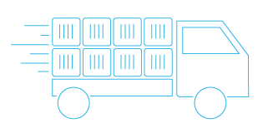
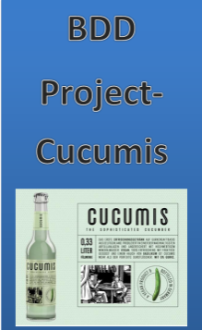
BDD and EIT
Requirement <-> Dev <-> Testing.

Slide 2






BDD POC Timeline
Feature Scenario
E2E Designer
Component Solution * Dev
Automation Code
EIT
System Under test
Tester
Component
Component – Dev + SCT (Mod B)
Hexagonal Architecture/ Port & Adapter code
GUI Automation
Example Mapping
Unit Test (AIB)
EIT
Step Definition
SaaS
AIB *
SI
Acceptance Test
G.W.T
Understanding Requirement
Automation Scripts
Preparation
Understand BDD
Cucumber.io
Hardware
Software
Project Planning – BTWCE-55649.
Monitoring and Control.
None
None
Project Design.
A
B
29/10 /15- 14/11/15
17/11 /15- 28/11/15
23/11 /15- 11/12-15
07/11 /15- 18/12-15

Slide 3
BDD POC Timeline
Feature Scenario
E2E Designer
Component Solution * Dev
Automation Code
EIT
System Under test
Tester
Component
Component – Dev + SCT (Mod B)
Hexagonal Architecture/ Port & Adapter code
GUI Automation
Example Mapping
Unit Test (AIB)
EIT
Step Definition
SaaS
AIB *
SI
Acceptance Test
G.W.T
Understanding Requirement
Automation Scripts
Preparation
Understand BDD
Cucumber.io
Hardware
Software
Project Planning – BTWCE-55649.
Monitoring and Control.
None
None
Project Design.
29/10 /15- 14/11/15
17/11 /15- 28/11/15
07/11 /15- 30*/12/15
A
B
23/11 /15- 11/12-15
Result (Phrase 1)
Self learning – Cucumber.io $199 USD
Hardware – Ronnie Laptop
Identified SW ( QTP, MVN, IntelliJ, Cucumber )
Result (Phrase 2)
BTWCE -55649 , AC 55963 (Biz Zone, BTW.com, SaaS) -> myBTWCE55649Max_Interconne_Routers.feature, creating GWT using Gherkin language.
Successful installed Cucumber in IntelliJ (mostly use) and installed Spec flow in Visual Studio (.Net)
Successful create adapter between Cucumber and SaaS . The duration to create the automation script and adaptation new framework is 5 man days. ***
Successful create CI work flow using Electric Flow *, Jenkins, Docker * and GIT. (Idea *)
Gap (Phrase 3)
Create full acceptance test, ACS ordering and create flow.
Create adapter between Cucumber and SI
Test CI workflow * Jenkins * Docker

Slide 4
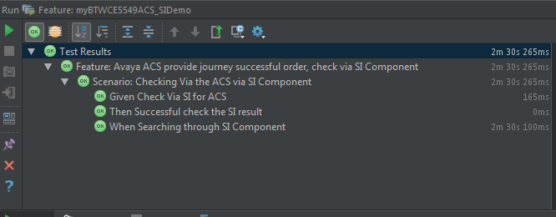
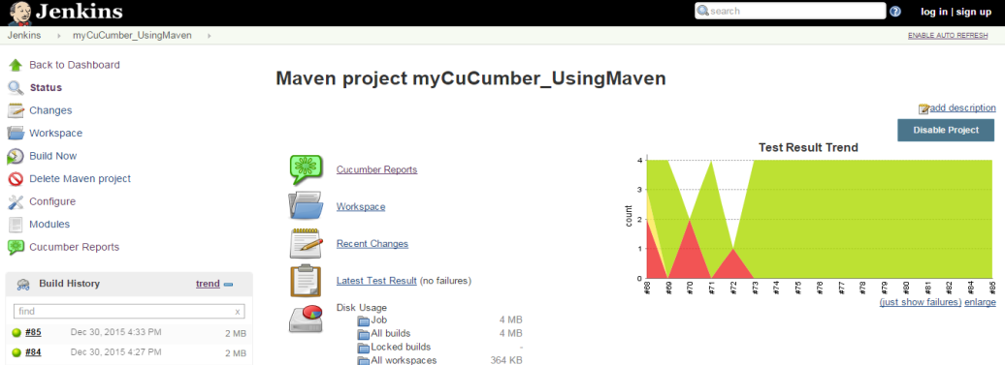
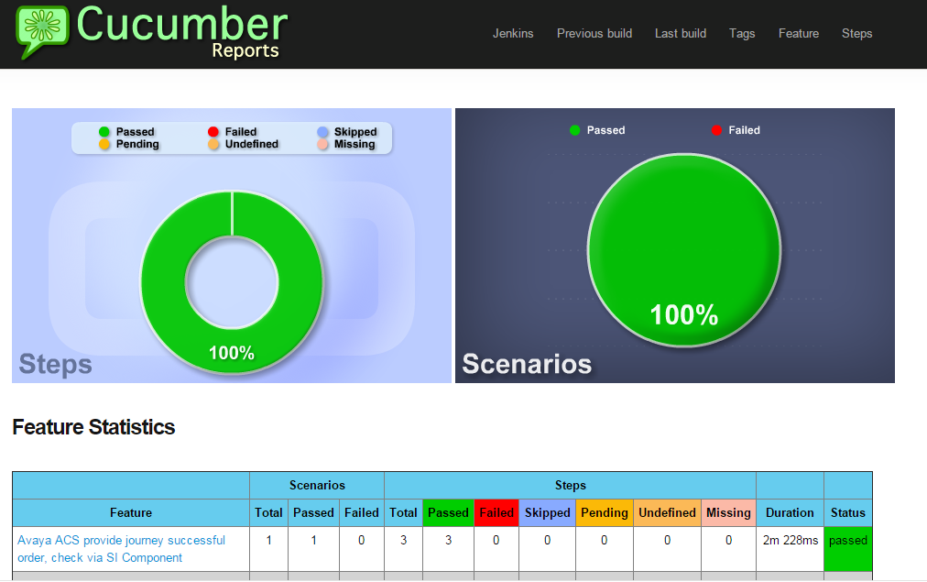
BDD POC Result
Highlight
Successfully implement Cucumber BDD adapter for SaaS and SI components * , via UFT-QTP (Web automation) and Jenkins (workflow and virtualization). See figure.
This allows Designer / Tester/ Developer able to test against the requirement and implementation more closely and integrated. See figure
It is living document (*accuracy, truth state, versioning)and source of truth (* Keep requirement document, test and code all in sync)

Slide 5
BDD POC Result
Lowlight
The result is not consistent.
Component availability in model ?
Service availability?
Waiting time.
This makes Acceptance Test hard to achieve (** for this POC, will not see in this POC)
There is an opportunity to improve here.

Slide 6
BDD Next Steps
Implement more adapters (i.e. DB support, XML Support, Log Support ,JSON Support)
Allow more components support, interaction and availability. (Refer to Pyramid of testing) See figure
Possible to identify gaps earlier.
Model maturity.
Ensure stability of model.
Educate users (Designer, Tester, Dev) to use Cucumber – Gherkin language.

Slide 7
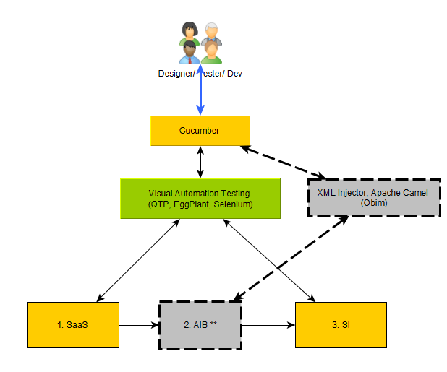
BDD- Result (Test Strategy)
A
B
C
D

Slide 8
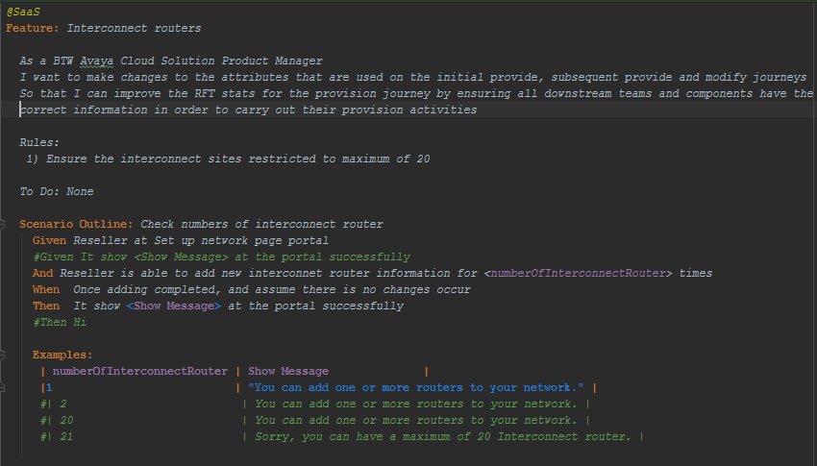
BDD- Result (Implementation )

Slide 9
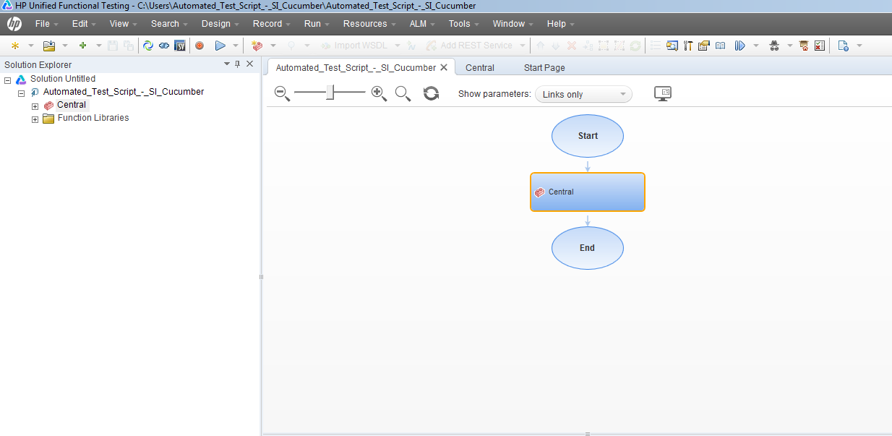
BDD- Result (Implementation QTP )

Slide 10
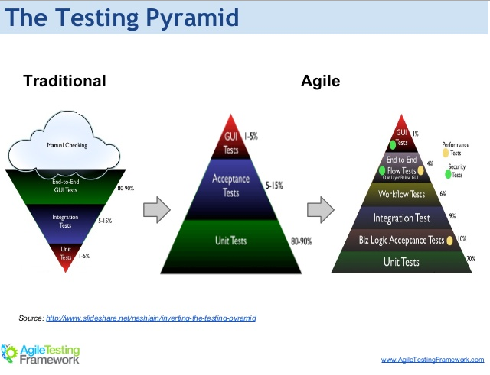



BDD- Result (Pyramid Testing )
Validation
Verification
http://www.softwaretestinghelp.com/what-is-verification-and-validation/

Slide 11
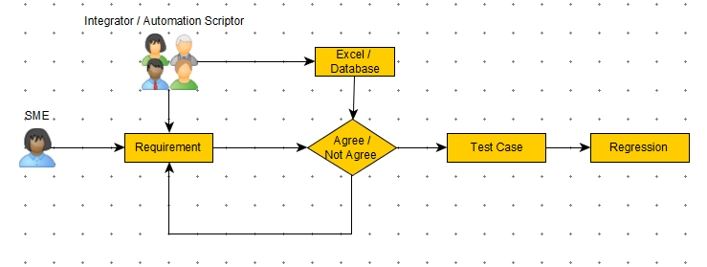
EIT – BDD- Before
Notes:
The current situation SME like SI CST and EIT Automation tester consolidate requirement from requirement (e.i. AC, CE, LLD) through CST call, KT, ,meetup, email or whatsup. There no framework. What bad here it is information sharing not testing mind set, awaiting CST test case , another set of EIT test case
EIT Automation tester equip with information, they prepare the automation scripts and Excel data .
EOD Regression test ready.

Slide 12
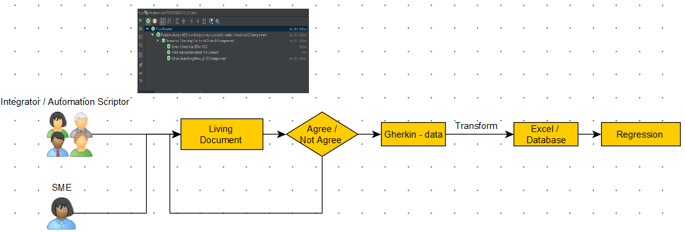
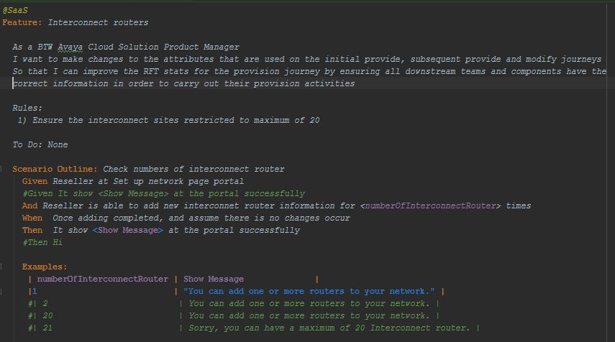
EIT – BDD- After
Notes:
The new framework , SME and Integrator working with Living Document closely. The requirement (e.g. AC, CE, LLD) is gather through CST call, KT, ,meetup, email or whatsup. What different here is a tight working collaboration of information exchange and creating test case. Basically it is common testing ground, it is single source of truth.
Upon agree, the Gherkin data will be convert/ transform to excel , CVS or DB either manual or automatically which can feed to regression process.
Benefit –
Living documentation (track changes) and working document (embedded with code), fine grained between Business, E2E and CST.
“Dan North described BDD as ‘a way to describe the requirement such that everyone – the business folks, the analyst, the developer and the tester – have a common understanding of the scope of the work. From this they can agree a common definition [sic] of “done”, and we escape the dual gumption traps of “that' s not what I asked for” or “I forgot to tell you about this other thing”.‘
Acceptance test (CST), with visualization.

Slide 13
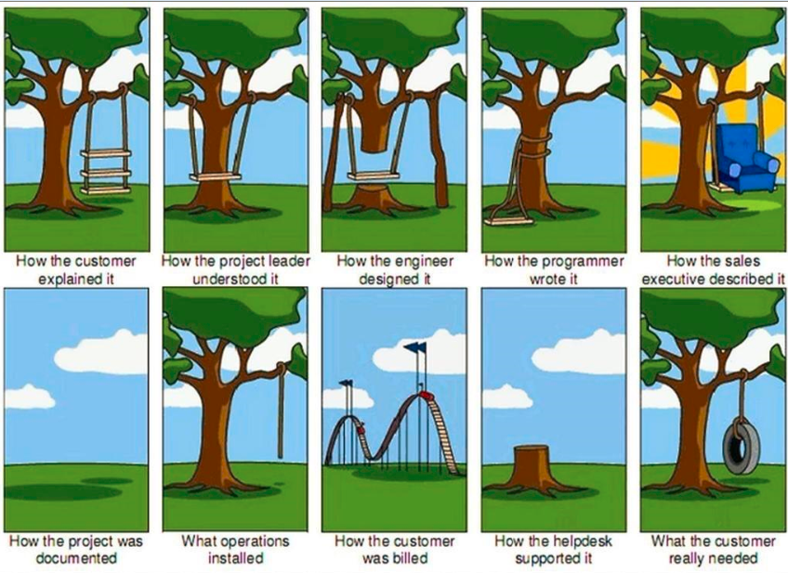
Lets' discuss, Discutons, Discutiamone,讓我們'討論, Lass uns diskutieren, Vamos discutir, Let ' a phlé

Slide 14








Next Steps – Common / Unified – Testing Perspective
Feature Scenario
E2E Designer
Component Solution * Dev
Automation Code
EIT
System Under test
Tester
Component
Component – Dve + SCT (Mod B)
Hexagonal Architecture/ Port & Adapter
Pyramid VS Ice Cream Cone Model
Example Mapping
Unit Test
EIT
Step Definition
SaaS
AIB
SI
“Design Specification Unit Test “.
Acceptance Test
Planning

Slide 15
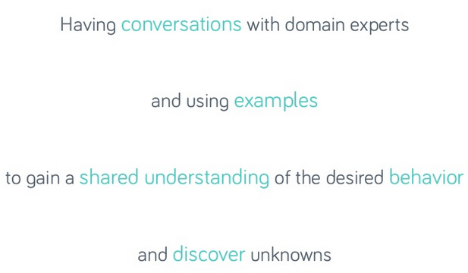
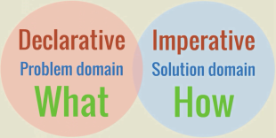
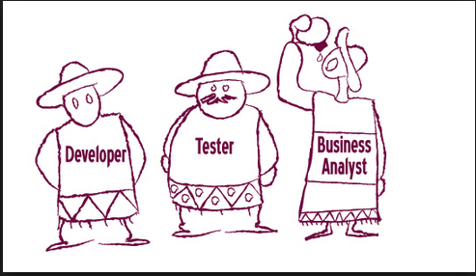
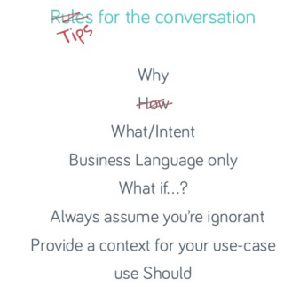
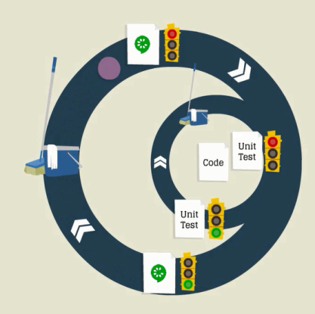
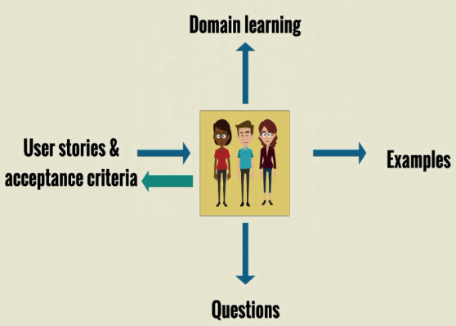

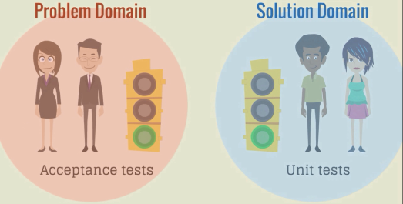
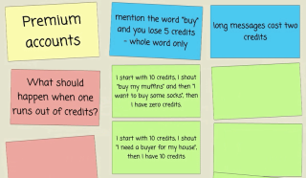
Feature Scenario
E2E Designer
Component Solution * Dev
Automation Code
EIT *
System Under test
Tester / EIT *
Component
Component (Mod B)
Hexagonal Architecture/ Port & Adapter
Pyramid Model
Example Mapping
Unit Test using BDD
EIT *
Step Definition
SaaS
AIB
SI
“Design Specification Unit Test “ ***
Acceptance Test
2 layer of filtering
……

Slide 16
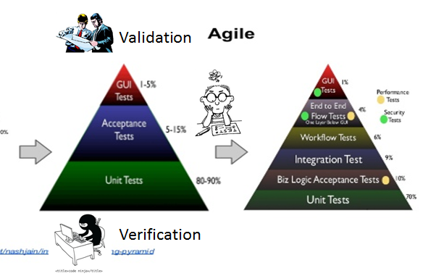
Solution
Process
Best Practice
Existing
Communication
Process flow

Slide 17
Communication
Process flow

Slide 18
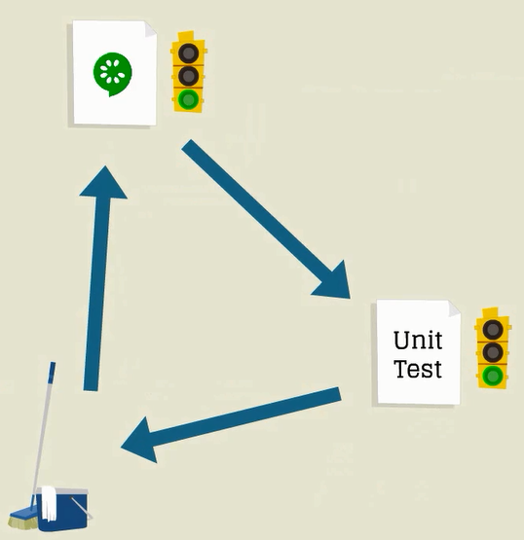
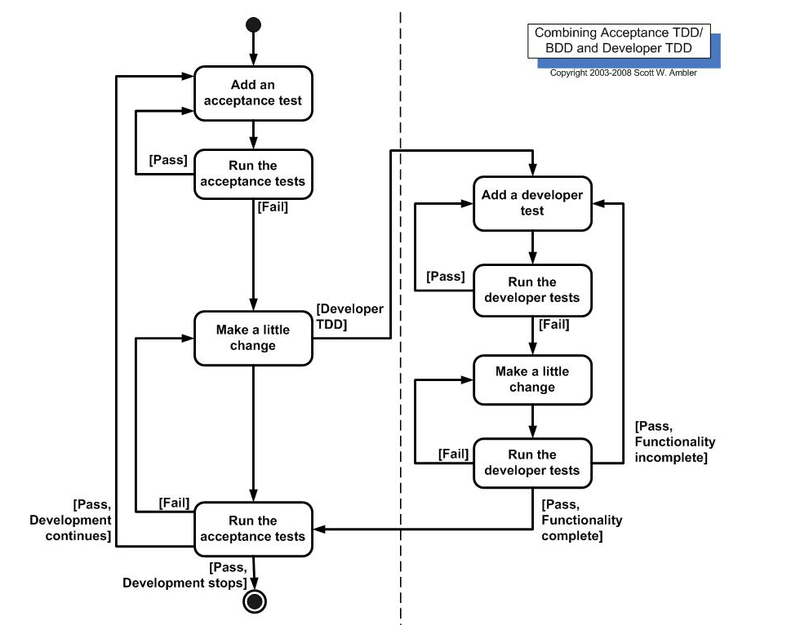

Workflow
Acceptance BDD
Dev BDD*/ TDD**
Notes:
Acceptance test = Build the right things
Unit Test = Ensure you build the things right

Slide 19
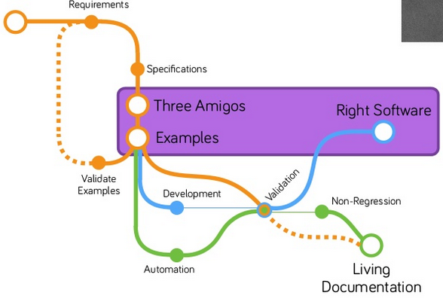

Slide 20

3 Amigos

Slide 21
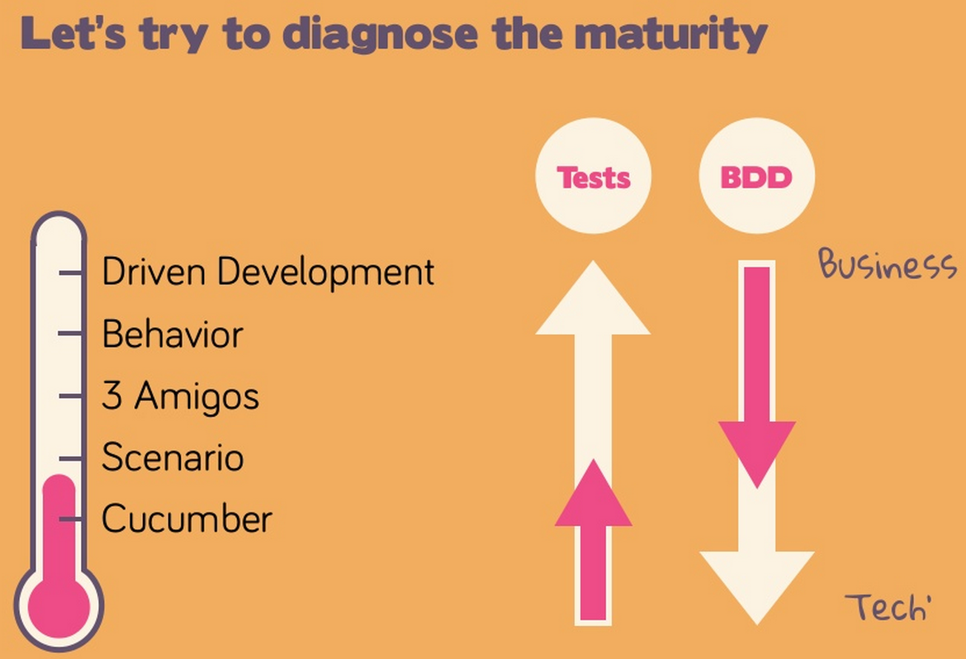

Slide 22
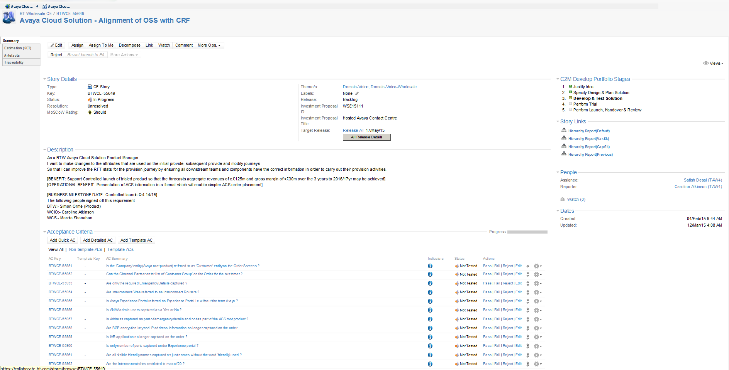
Problem Statements

Slide 23
Problem Statement
There is no proper formality standards and traceability to governance as well perform Requirement Management.
As a result, It is difficult to track and trace CE and AC what or which covered by which system components.
Biz Zone
SaaS
OS
SI
BAL
AIB
Pacs
?
BDD

Slide 24




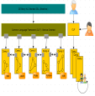
Test Requirement as earlier as possible
Day 7
Day 30
Day 90
Cost /Effort
Days’

Slide 25
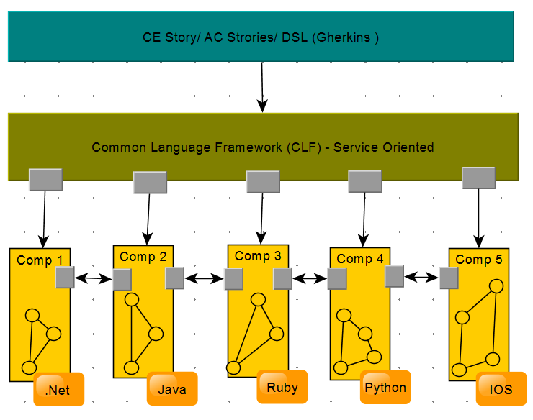
Next Steps – Common / Unified
Support large scopes including of CE stories, AC Stories and Components Solution.
It will work closely with specification, what business domain required.
It allow testing trigged from specification level down to component level.
CFL is common platform to allow E2E to perform testing

Slide 26
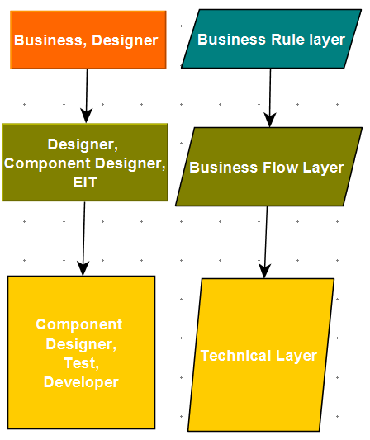

Next Steps – Common / Unified 2
Requirement will communicate using simple, human readable and collaboration technique – Cucumber’s plain text DSL (Domain Specific Language) called Ghenkin.
Everyone need to know Ghenkin.
Developers implement acceptance criteria.

Slide 27
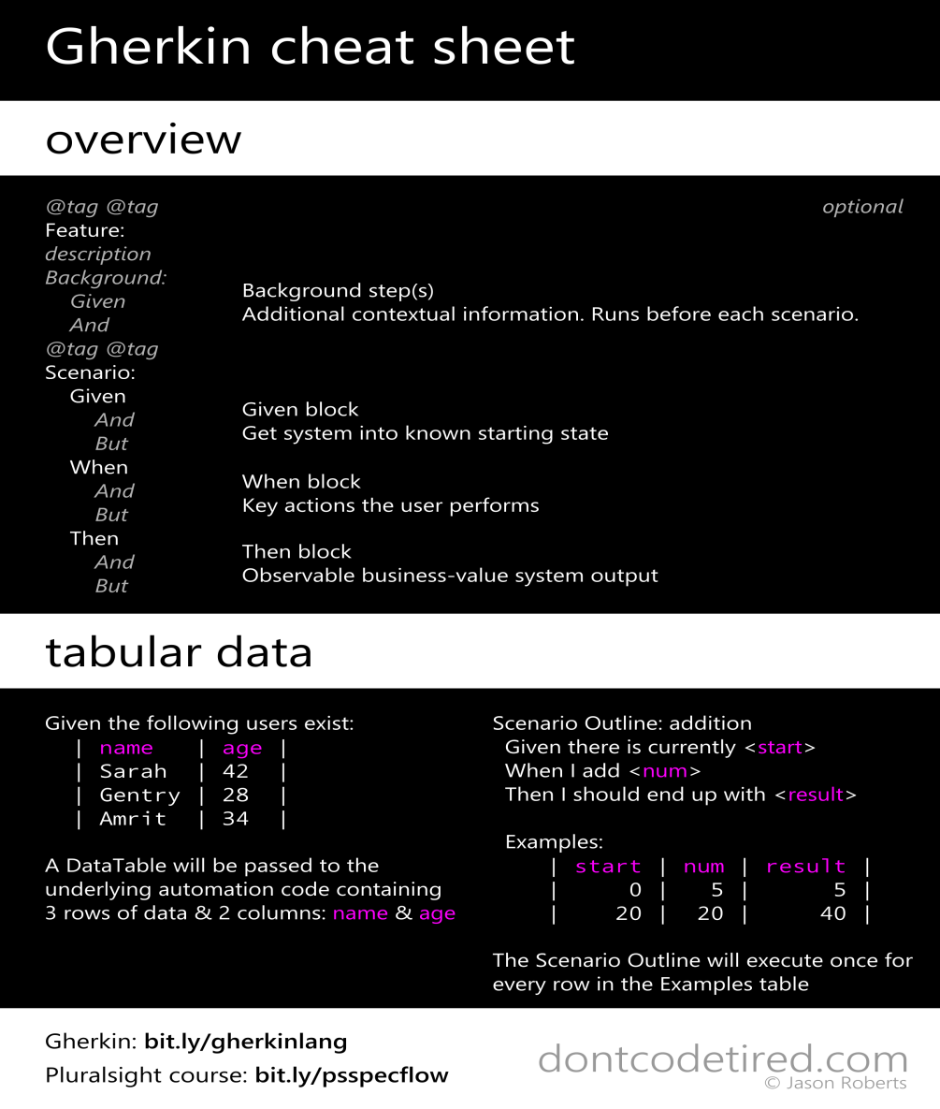
What is Ghenkin
Gherkin is a Business Readable Domain Specific Language. It allows the documentation of what a system should do in natural language (multiple languages are supported) and allows test automation code to be written for the system’s features. (http://dontcodetired.com/blog/post/Gherkin-Cheat-Sheet.aspx)

Slide 28

Next Steps – Common / Unified – Testing Perspective
Dynamic testing can be trigger within
Business Rule Layer
Business Flow Layer or
Technical Layer
Benefit
Requirement are easy to understand for both Business stakeholder, technical Project Manager, Dev and tester
Quality is “Build-in”, assessing requirement quality at the beginning of the process.
Allow easy adaptation to requirement changes
Tester can leverage and extend developer work
Traceability is relative easy
Support Java, .Net, Ruby, Pyhton, Droovy.

Slide 29
Feature File and Agile Workflow
Step 1 : User story / Requirement Elicitation & Elaboration with customer(s) or business owner – Feature file output
Step2 : user story (Feature file) Elaboration & Validation with QA
Step3 : Feature & Feature File implement by Developers
Step4: Tester test Functionality
Step5: Acceptance by Business Owner
Step6: Repeat

Slide 30
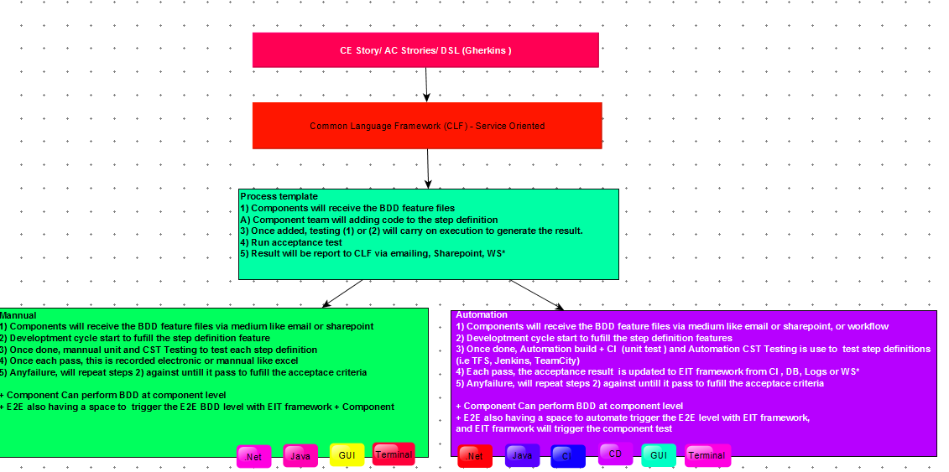
Roadmap
It can support both manual and automation process
BDD result will use as Acceptance criterial (UAT), Traceability matrix and requirement checklist .

Slide 31
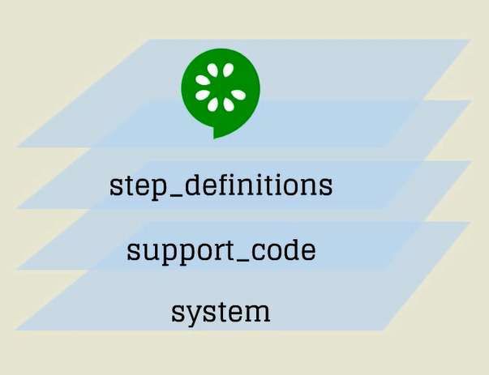
Support Code
Notes:
http://www.meetup.com/PMISydneyMeetup/events/219974357/
Example Mapping
EIT tester as inspector for E2E designer ? By perform Design Unit Test Layer

Slide 32
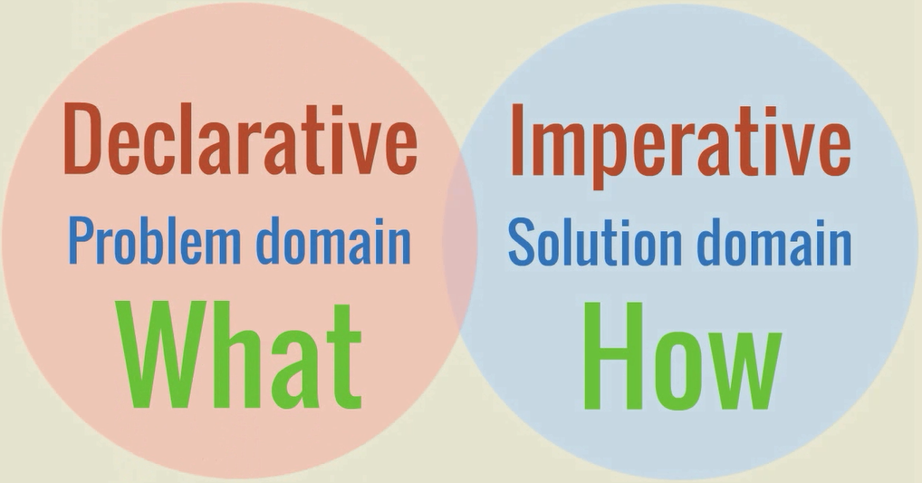
What VS How

Slide 33
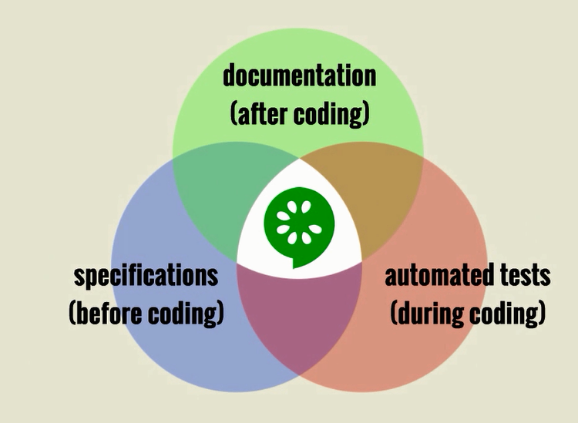

Slide 34

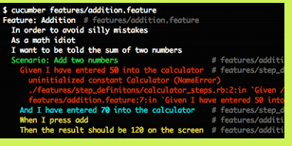
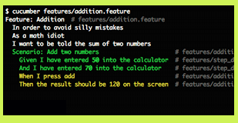
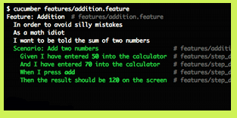
BDD in EIT (SI.BUZ.Logic)
_TC | _Description | _Execution | _Result
TC0 | Feature : PRECON & LOGIN IN ORDER access to SI PAGE to perform task/functional/regression Testing As A: SI CST/AUTOMATION Tester WANT : Able to Login to SI Page successfully Scenario : Able to Login Only GIVEN : SI Portal Page [MOD-B] AND/OR : Able to loging to SI WHEN : SI access granted THEN : URL initiated with successful Login and ready/available to perform functional/regression Testing | NO | FAIL
TC1 | Feature : CHOOSELOB IN ORDER to choose a correct LOB (Only One LOB at the time allow) As A: SI CST/AUTOMATION Tester WANT : Able to One LOB successfully Scenario : Able to Choose ONE LOB Only GIVEN : SI Portal Page [MOD-B] AND/OR : Able to logging to SI WHEN : Given the value BTO L2C THEN : BTO L2C Choose, and Global Services, Avaya L2C, TSO L2C and Avaya BTO L2C not choose | NO | FAIL
_TC | _KEYWORD | _Description | _DATA | _ADDSHEET | _Result
TC0 | PRECON | Precondition | C:\Users\Common\608271703.xls |  | FAIL
TC0 | LOGIN | Login to SI Page | C:\Users\Common\608271703.xls | Action1 | FAIL
TC1 | CHOOSELOB | Choose Particular LOB | C:\Users\Common\FVLOB.xls | LOBUSED | FAIL
TC2 | CHANGEROLE | Change to become WorkAnalyst | C:\Users\Common\ChangeRole_WA.xls | USER_ROLE | FAIL
TC3 | ASSIGNWORKAREA | Assign Work Area | C:\Users\Common\WorkAreaAssignment.xls | Action1 | FAIL

Slide 35
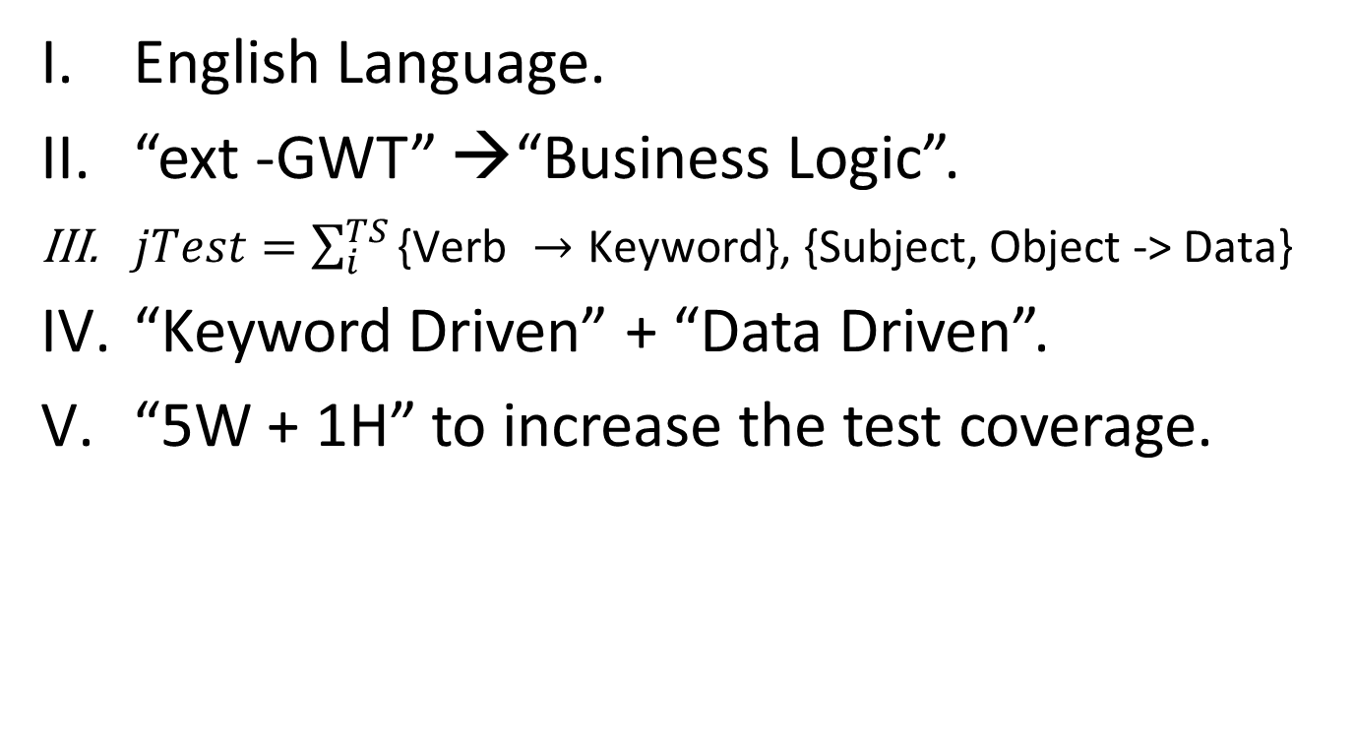
EIT – Gherkin (DSL)
English Language.
“ext -GWT” →“Business Logic”.
$jTest=\sum_{i}^{TS}{\text{\{}\text{Verb} →\text{Keyword}\text{\}, \{}\text{Subject}\text{, }\text{Object}\text{ −> }\text{Data}\text{\}}}$
“Keyword Driven” + “Data Driven”.
“5W + 1H” to increase the test coverage.
 | WHAT | WHEN | WHO | WHICH | WHERE | HOW | Permutation
PRECON & LOGIN | To do , Option | Date, Time | Who allow to do login | Version , | Place, Location, Server | Method, process | 6 *

Slide 36
Observation
EIT is not fully use the BDD practice.
Testers is not make use of the DSL / BDD, therefore promoting, planning, controlling and monitoring are needed.
Visual / Graphical will give better understanding (i.e. BPMN + BDD, Swim lane + BDD)
There no framework for UFT/ QTP
Jasmine (JavaScript framework)
Concordion (Java framework)
Cucumber-js(Javascript framework)
SpecFlow (.NET framework)
Workflow (i.e. Teamcity, Jenkins)

Slide 37
Tool Criteria
It must be high flexible with ability to integrate with any tool
Web automation (Selenium/ Watir/ Capybara)
Various Language ( Java, .Net etc)
Build Systems – Ant, Rake, Hudson
Living Document

